Slide 1


Kids App
“Logical Limit”
A Sample Database:
By Dilafruz Shamsieva
&
Nash Hearn

Slide 2
INTRODUCTION
Logical Limit
Creating a Database for logical limit application
Structuring the Tables inside of the Database
Loading values into the Tables
UML Design of the Database

Slide 3
LOGICAL LIMIT
Content management application for screen time control. (Children ages 14 and under)
Considering the complexity of working with modern children, who are often attached to the electronic devices, we offer a method that will allow children to retain valuable knowledge in certain areas of education in a playful way.

Slide 4
Technology
MySql (for DB)
Flutter (Language Dart)

Slide 5
SCOPE
Create a child-friendly program that will help the user complete the task of controlling a child's device.
Database Management to include tables necessary to contain user information, dependent information, and subscription information
encryption for payments and educational results would be a stretch goal

Slide 6

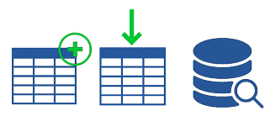
Tables:
Parent
Child
Subscription
Message
Device
Location
Usage Report
Emergency Signal
Task

Slide 7
PARENT TABLE:
CREATE TABLE Parent (
fname VARCHAR(50),
lname VARCHAR(50),
DOB DATE,
phone VARCHAR(15),
email VARCHAR(100),
child VARCHAR(50),
spouse VARCHAR(50),
subscription BOOLEAN DEFAULT false,
sign_on TIMESTAMP DEFAULT CURRENT_TIMESTAMP,
ssn VARCHAR(11) PRIMARY KEY,
FOREIGN KEY (child) REFERENCES Child(Pssn)
);

Slide 8
CHILD TABLE:
CREATE TABLE Child (
fname VARCHAR(50),
lname VARCHAR(50),
DOB DATE,
age INT,
ssn VARCHAR(11),
pssn VARCHAR(11) PRIMARY KEY
);

Slide 9
SUBSCRIPTION TABLE:
CREATE TABLE Subscription (
Status BOOLEAN DEFAULT true,
Type VARCHAR(50),
Amount DECIMAL(10, 2),
Ssn VARCHAR(11) PRIMARY KEY,
Active_Since TIMESTAMP DEFAULT CURRENT_TIMESTAMP,
Inactive_Since TIMESTAMP DEFAULT NULL,
FOREIGN KEY (Ssn) REFERENCES Parent(ssn)
);

Slide 10
LOCATION TABLE:
CREATE TABLE Location (
Status BOOLEAN DEFAULT true,
Location_id VARCHAR(11) PRIMARY KEY,
Signal_Type VARCHAR(50),
Latitude DECIMAL (10, 8) NOT NULL,
Longitude Decimal (11, 8) NOT NULL,
child VARCHAR(50),
FOREIGN KEY (child) REFERENCES Child(pssn)
);

Slide 11
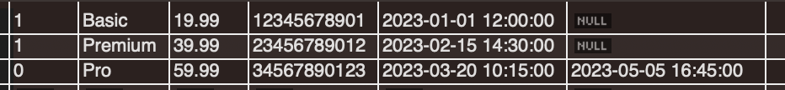
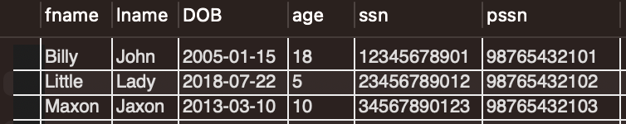
PARENT:
SUBSCRIPTION:
CHILD:

Slide 12
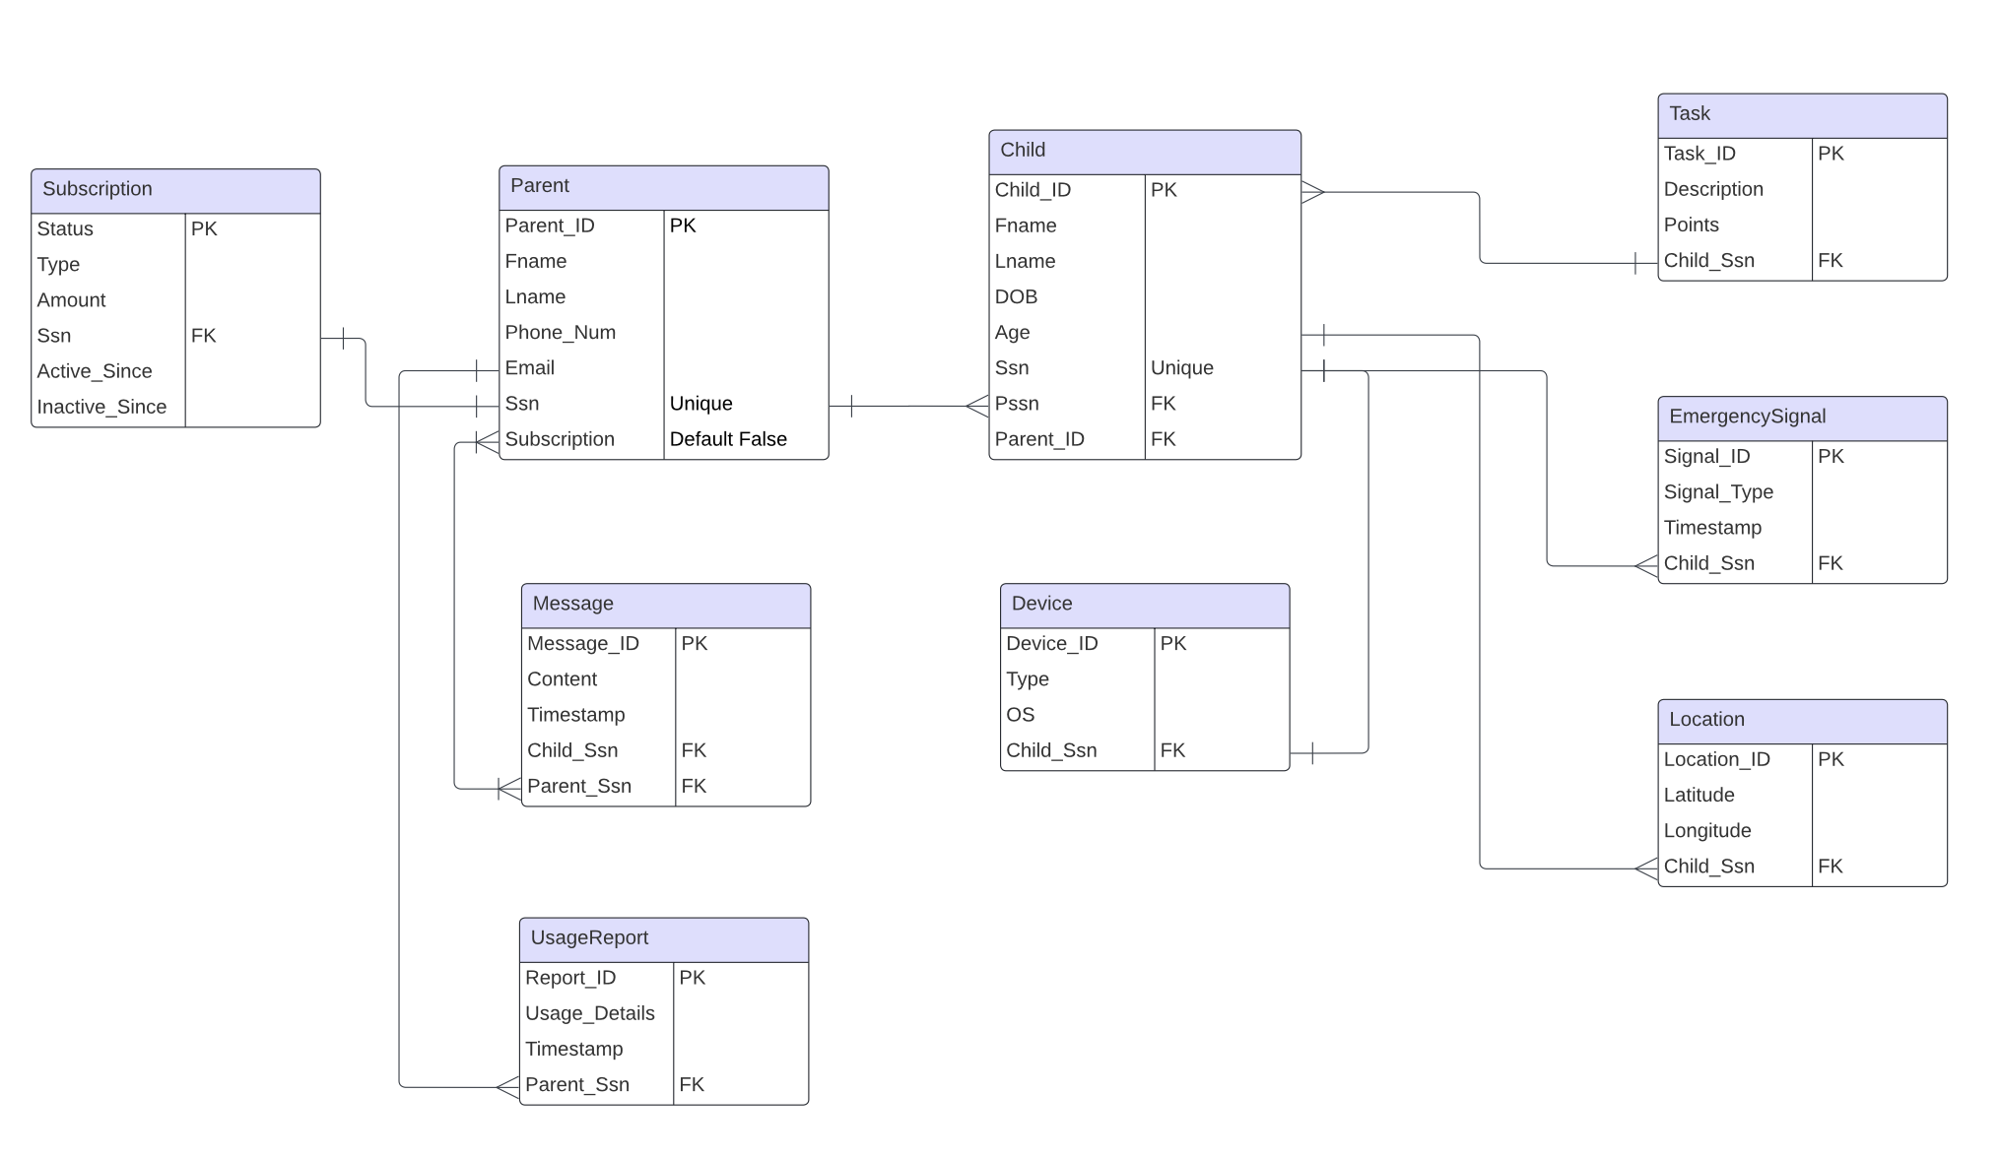
UML:

Slide 13
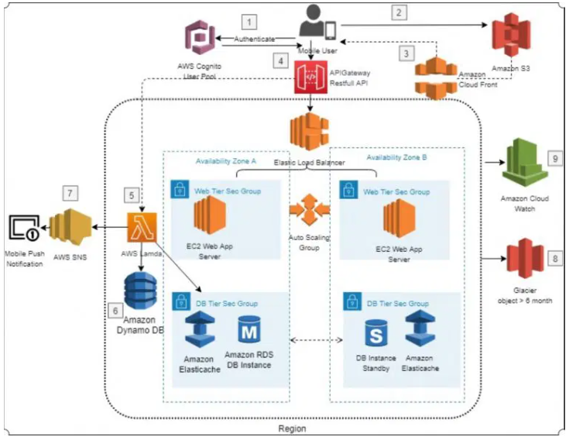
MODEL ARCHITECTURE
Model architecture uses a LAMP stack comprising of open-source software
For mobile-based architecture represents a RESTful mobile backend infrastructure that uses AWS-managed services

Slide 14

APP DEVELOPMENT PROCESS
Flutter an open source framework by Google will be used to build multi-platform applications from a single codebase.
Flutter code compiles to ARM or Intel machine code as well as JavaScript, for fast performance on any device.

Slide 15
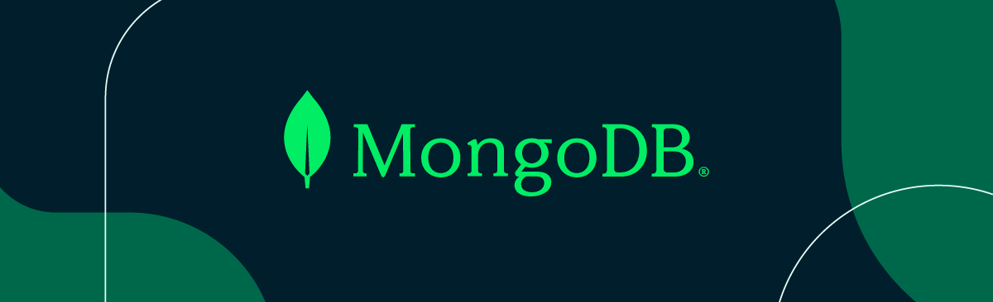
MongoDB, a NoSQL database, emerges as a fitting choice for Logical Limit's app database
Flexible Schema Design
Scalability
Rich Query Language
JSON/BSON Data Model
Automatic Sharding and Replication

Slide 16
USER INTERFACE DESIGN

Slide 17
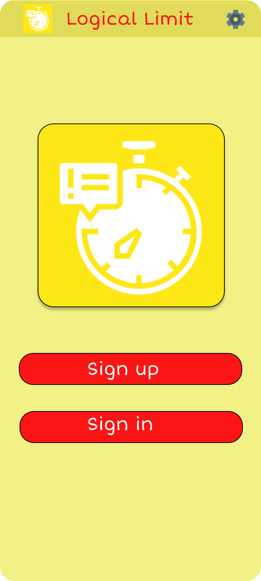
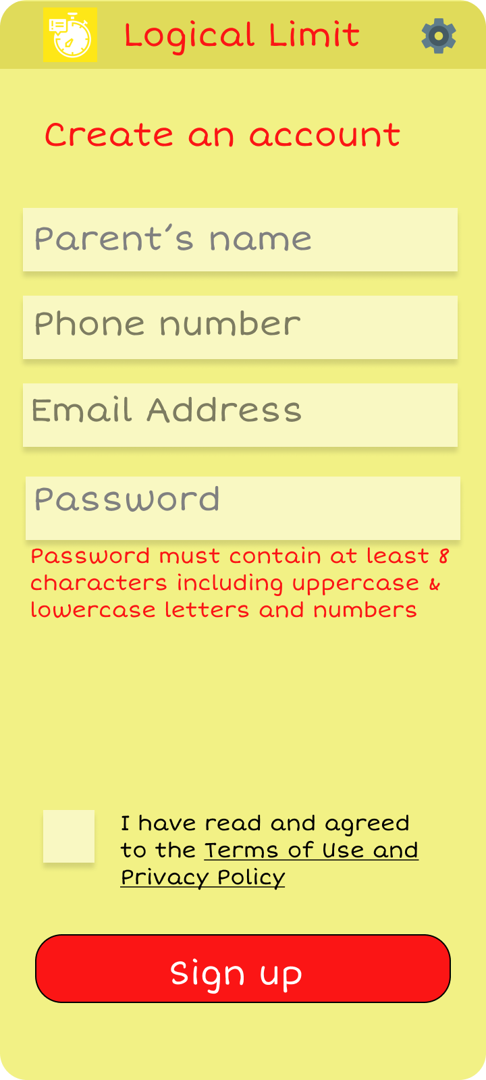
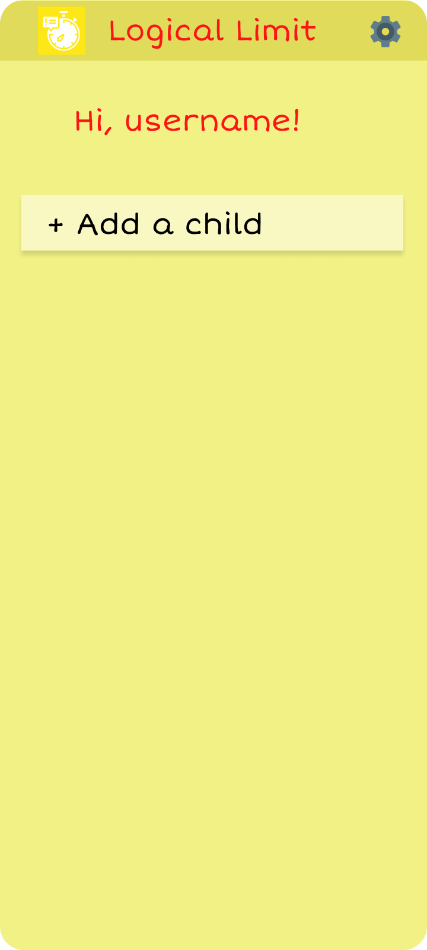
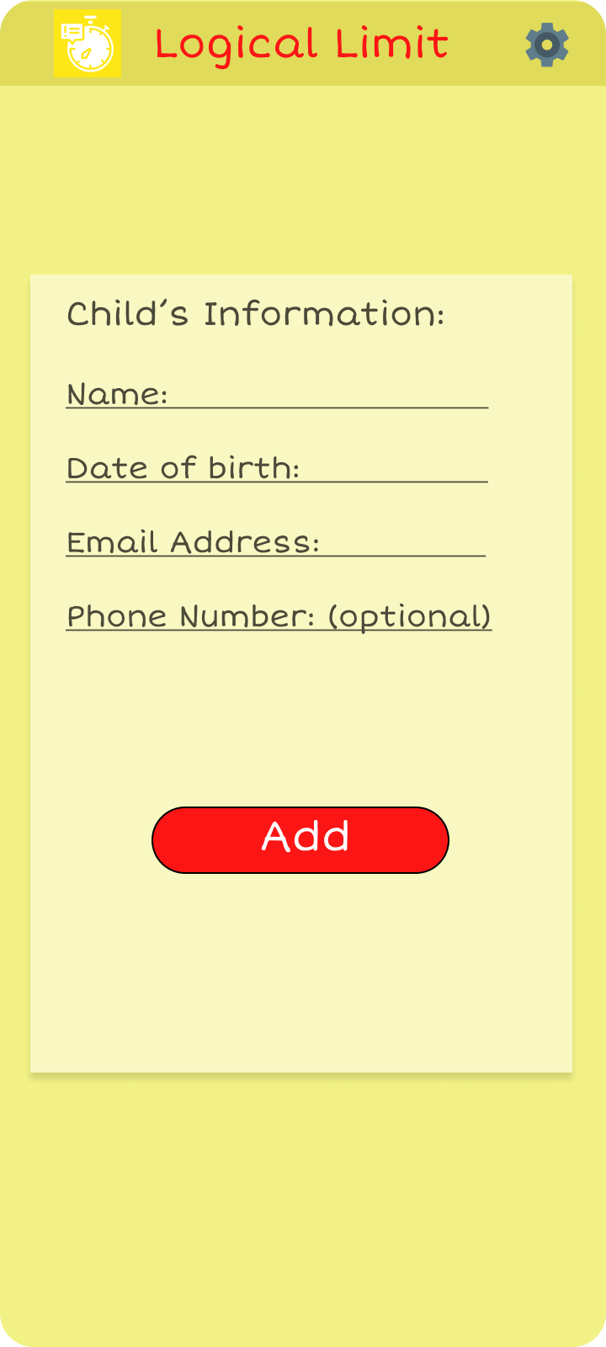
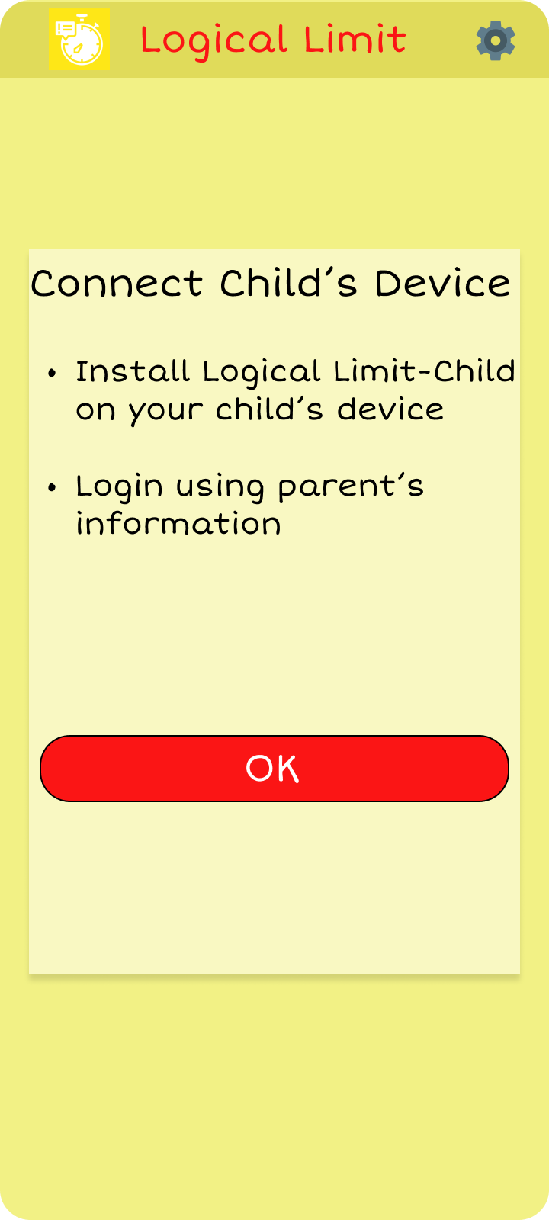
Interface of parent's app
Creating an account by writing information about parent and a child
All activities automatically appear after determining the age of the child

Slide 18
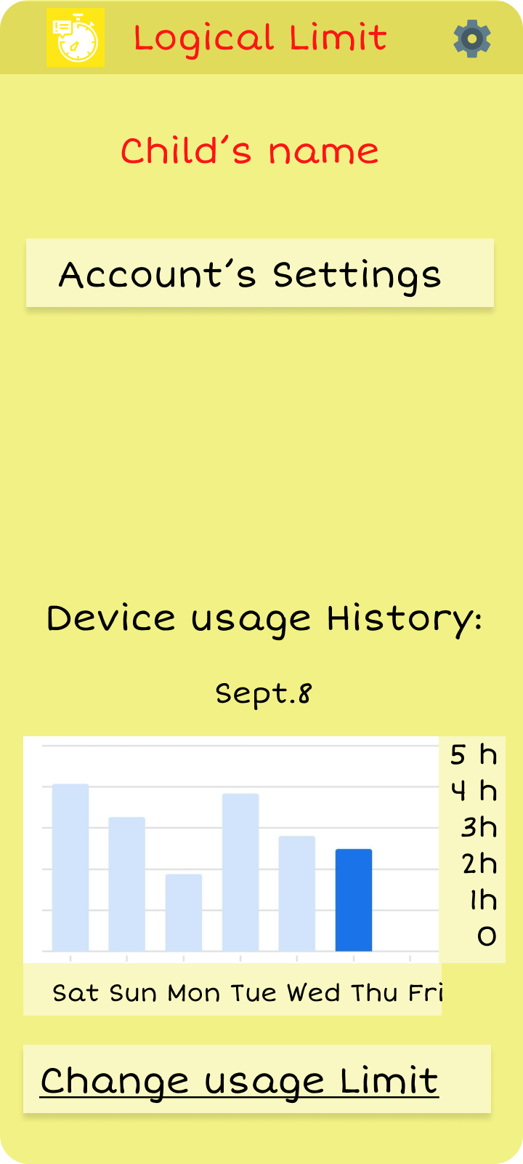
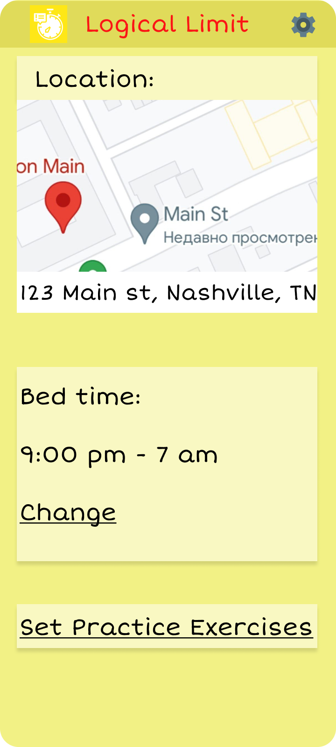
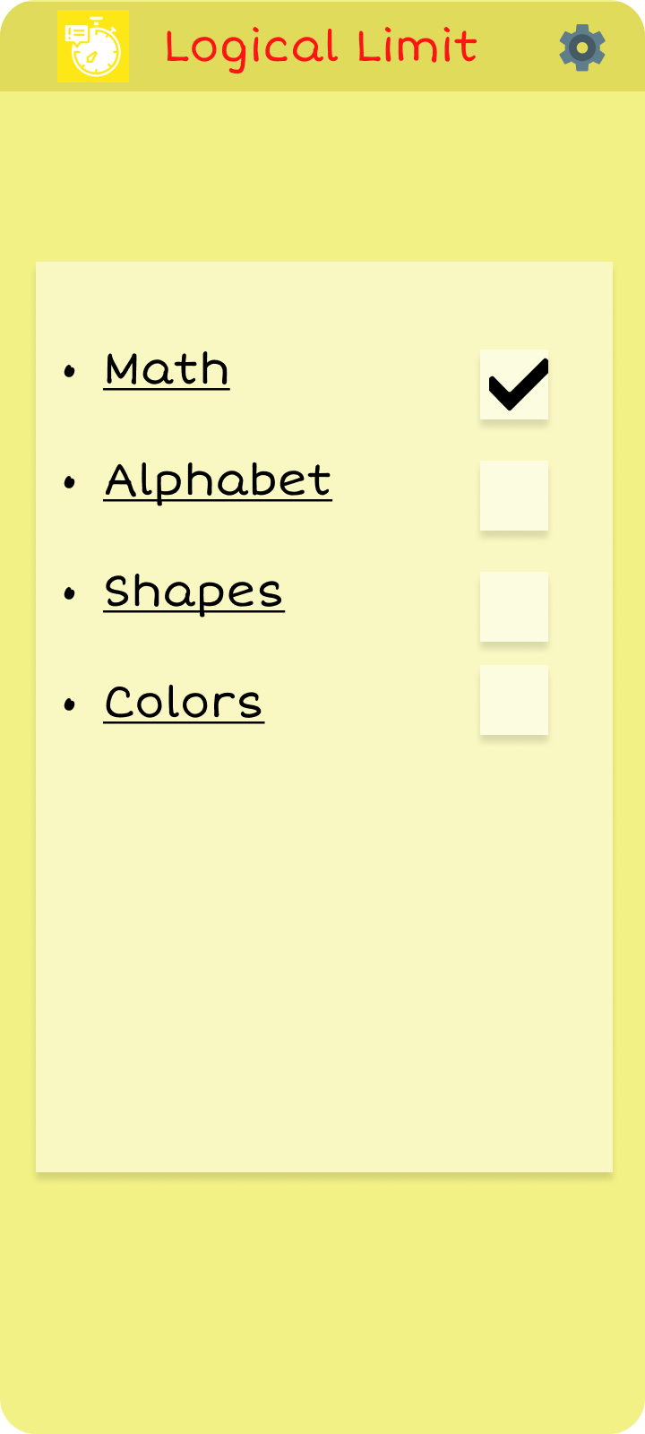
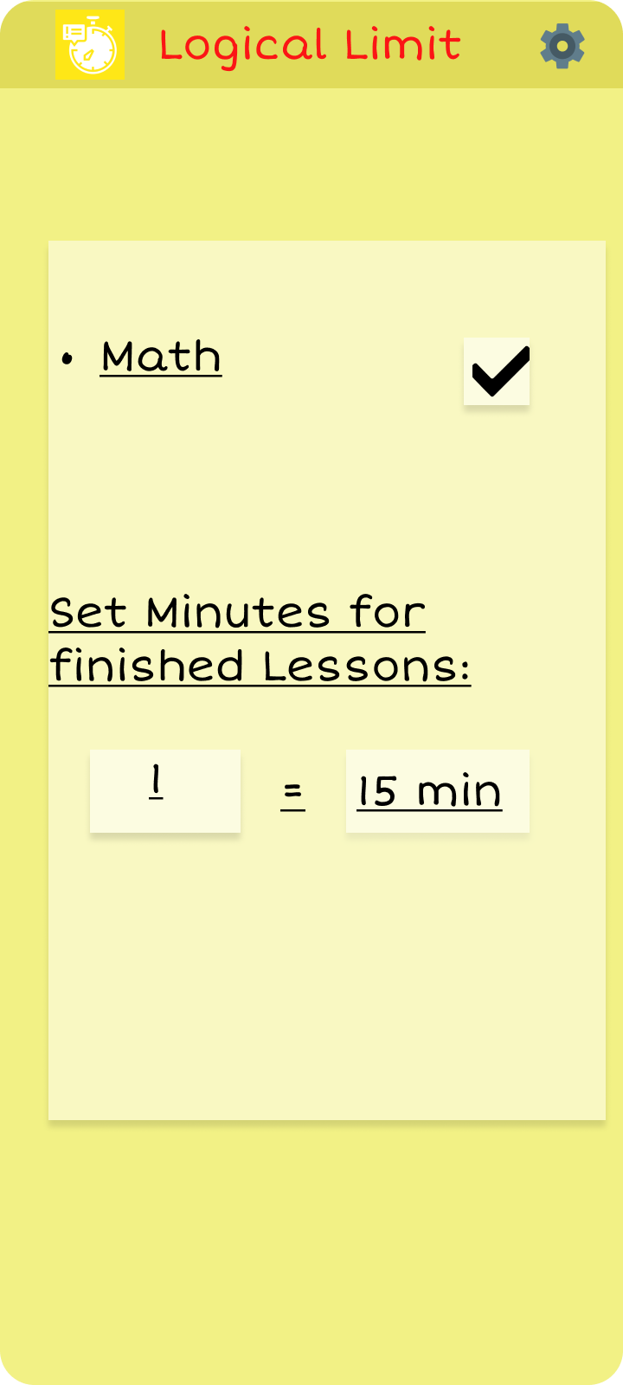
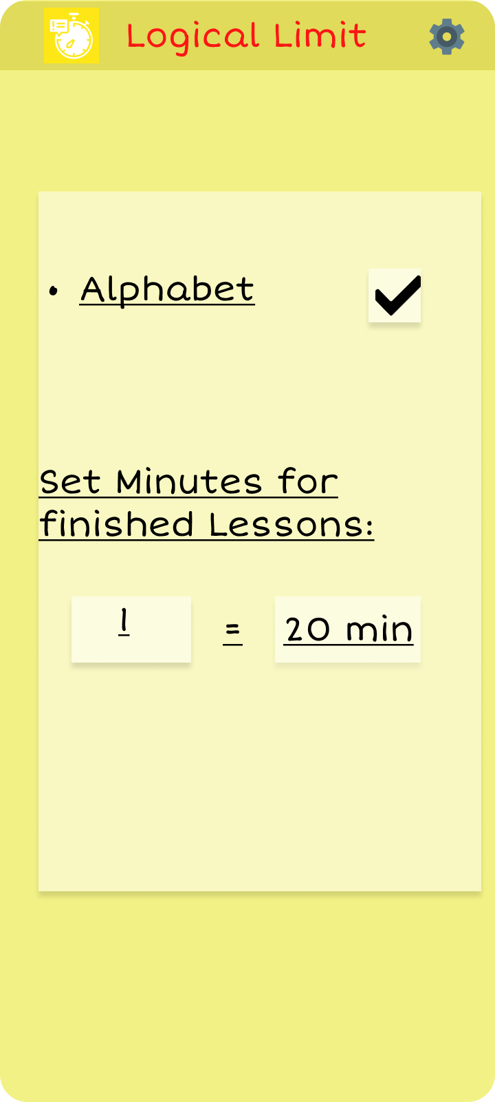
Inside of the app you have options to set up the account.
Look the device sage History
Change usage time
You can track the location of a child
Set the Practice Activity
Example of setting up activities for Pre-K and K children

Slide 19
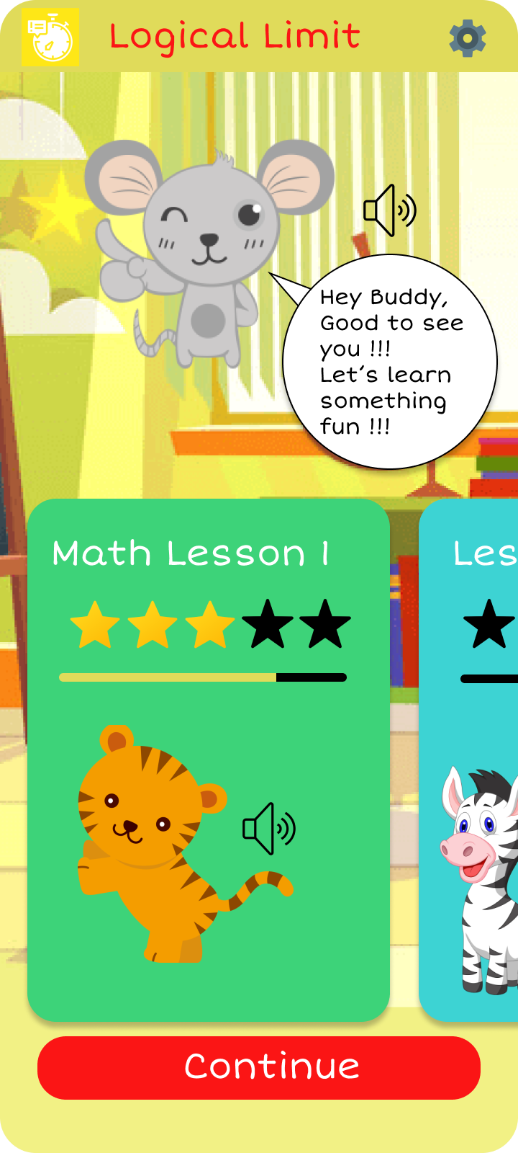
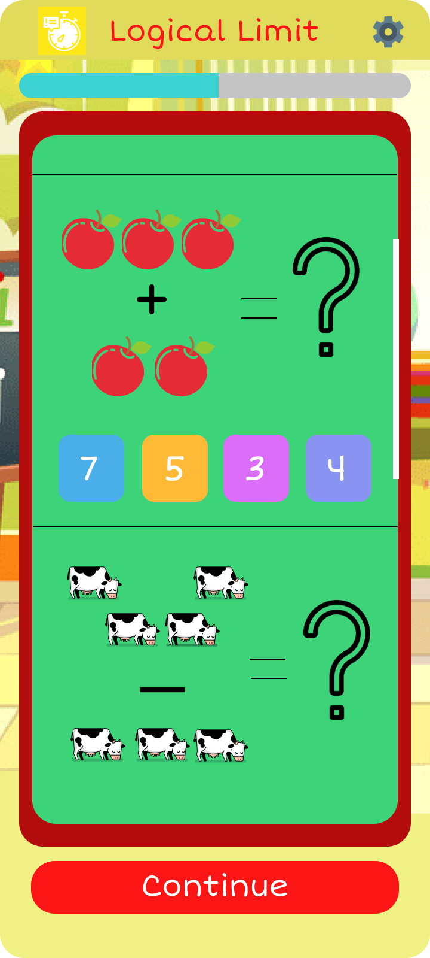
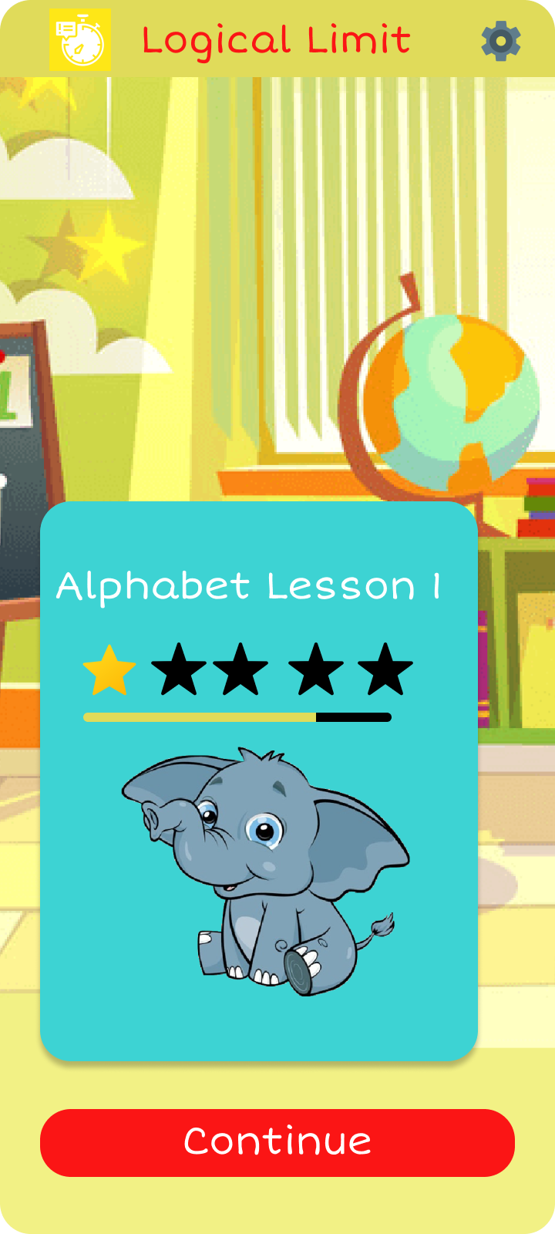
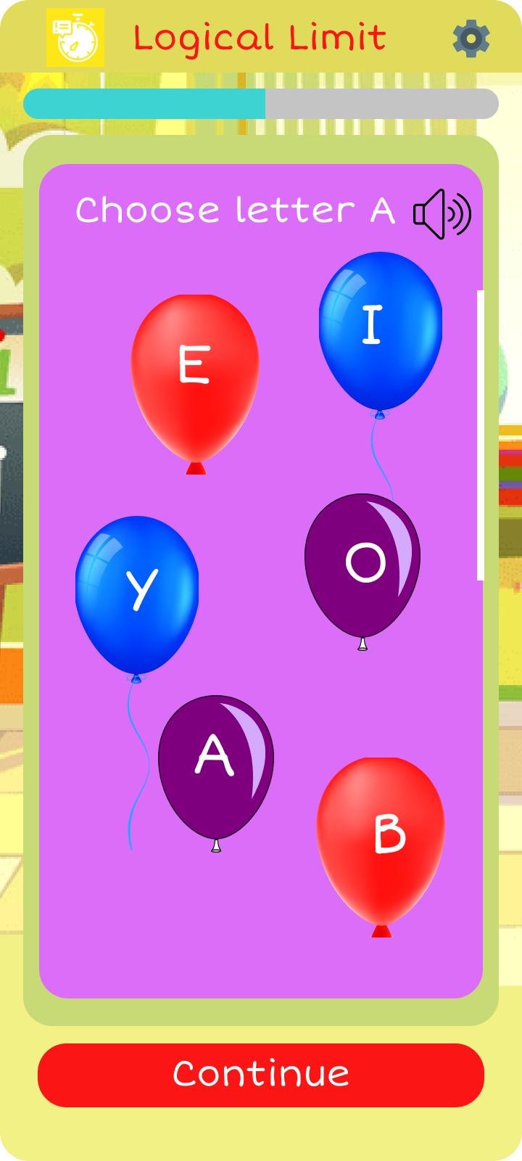
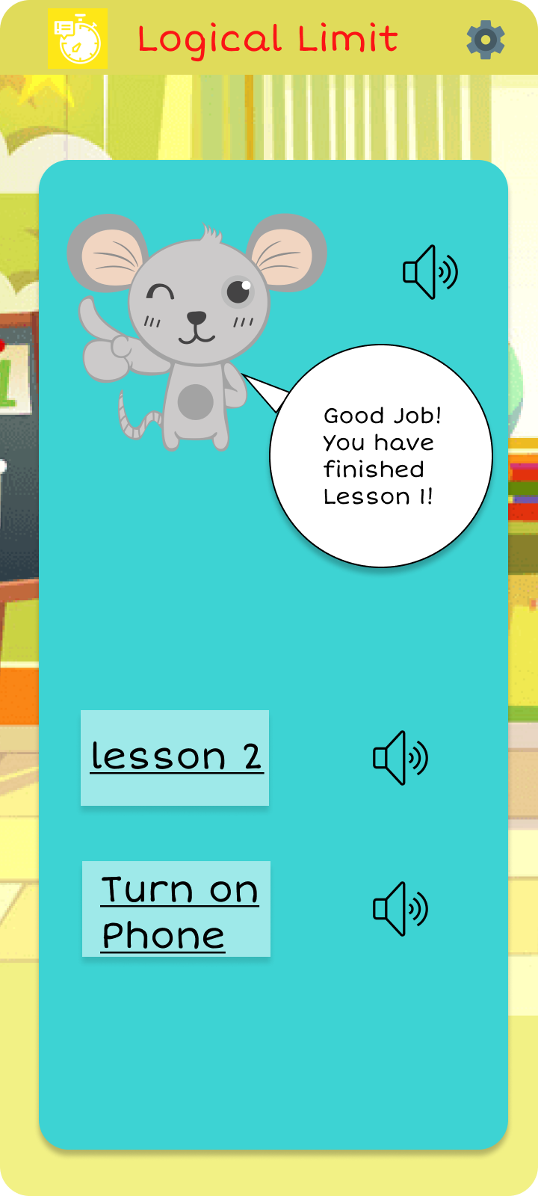
Example activities for Pre-K and K children in Math and Alphabet section
Result after finishing lesson 1, all buttons have option to play audio, for the kids who don't know how to read

Slide 20
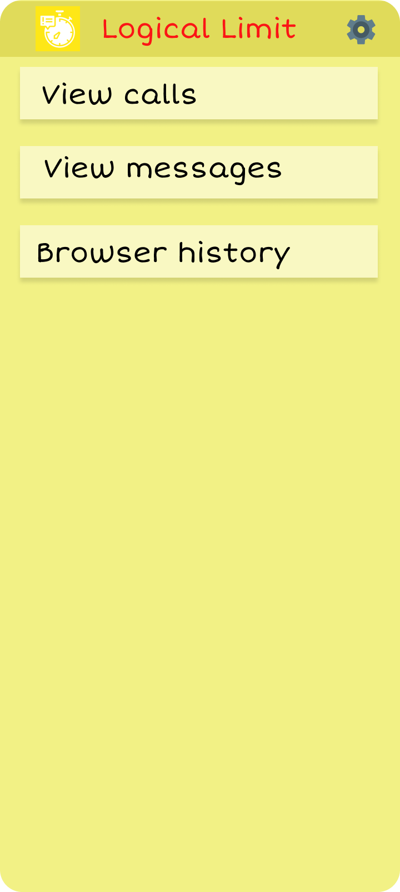
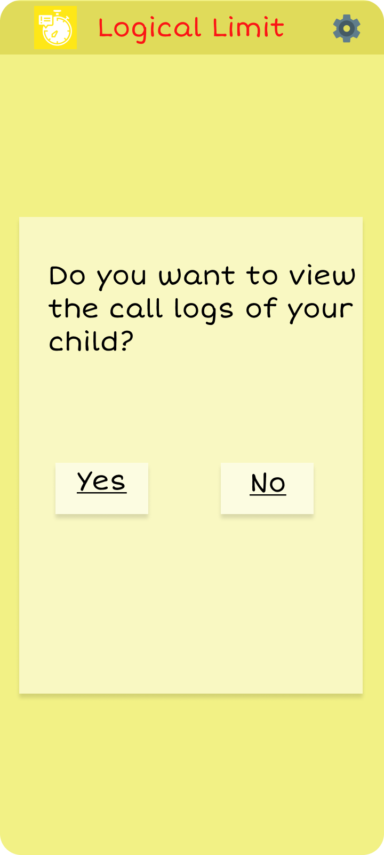
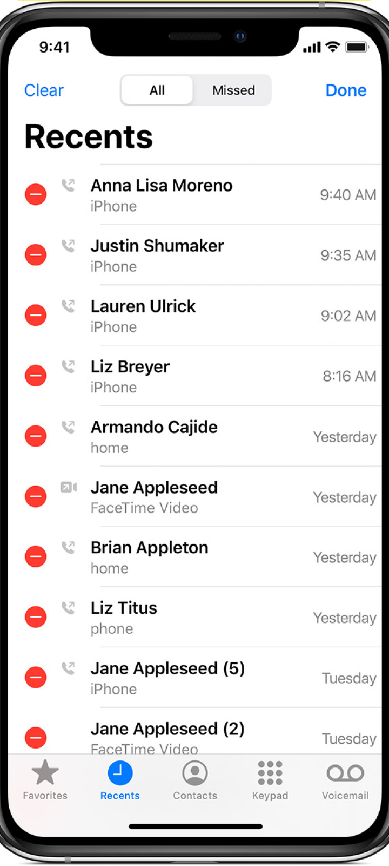
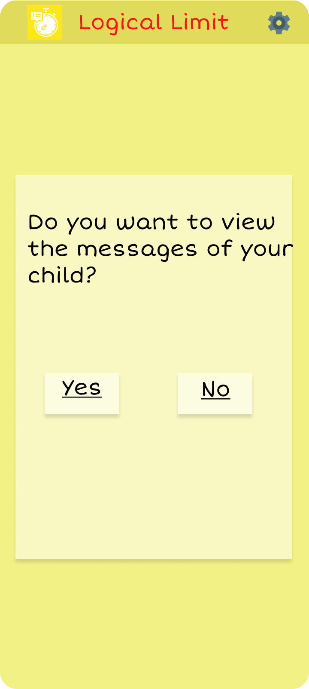
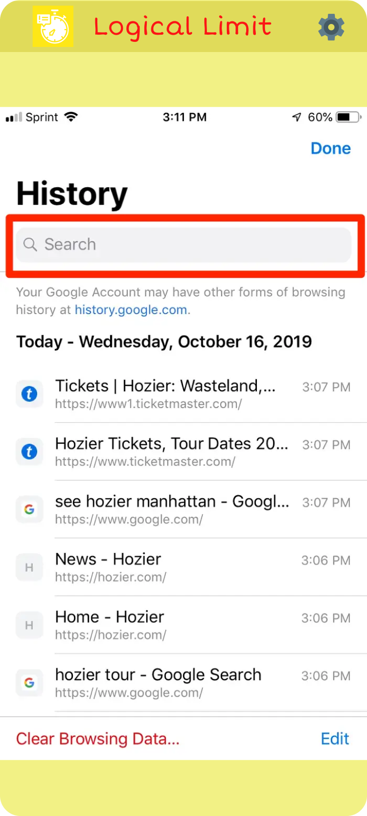
A feature to track calls, messages and browser history
Notify parents what data had been sent to third party applications. An ability to block it.
You can easily block the websites that you think are harmful for kid.

Slide 21
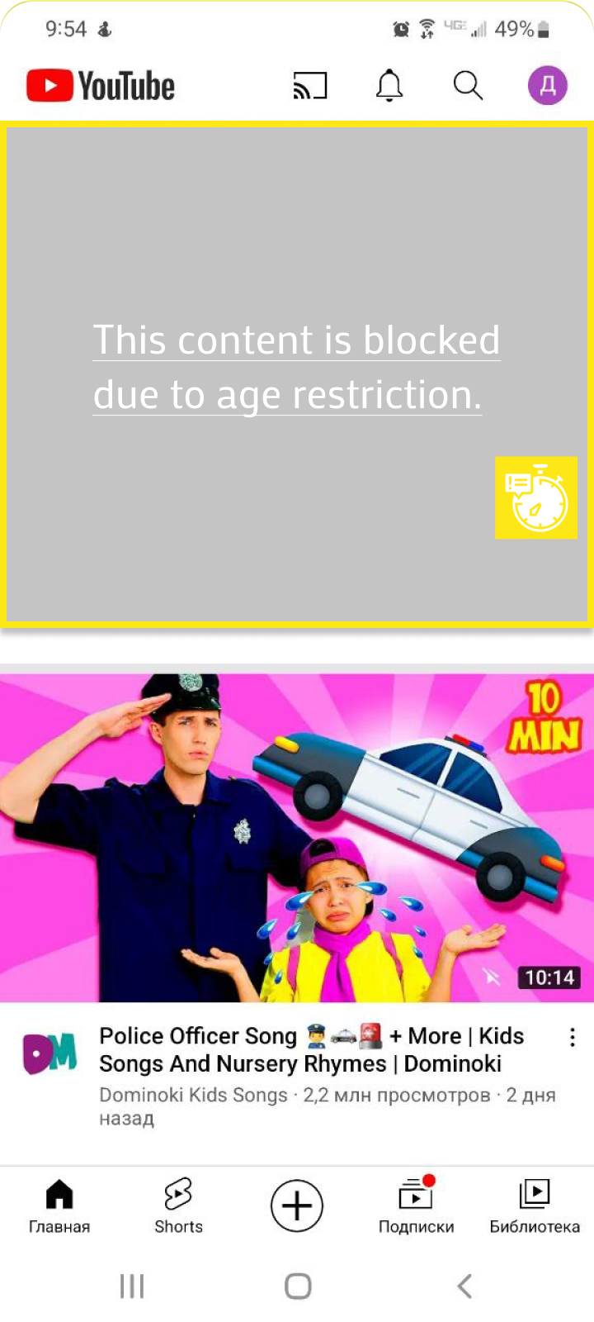
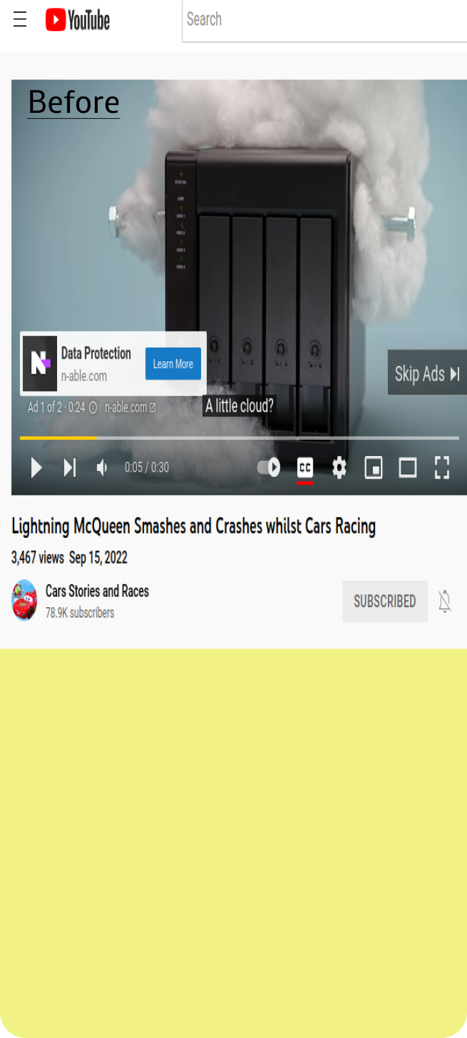
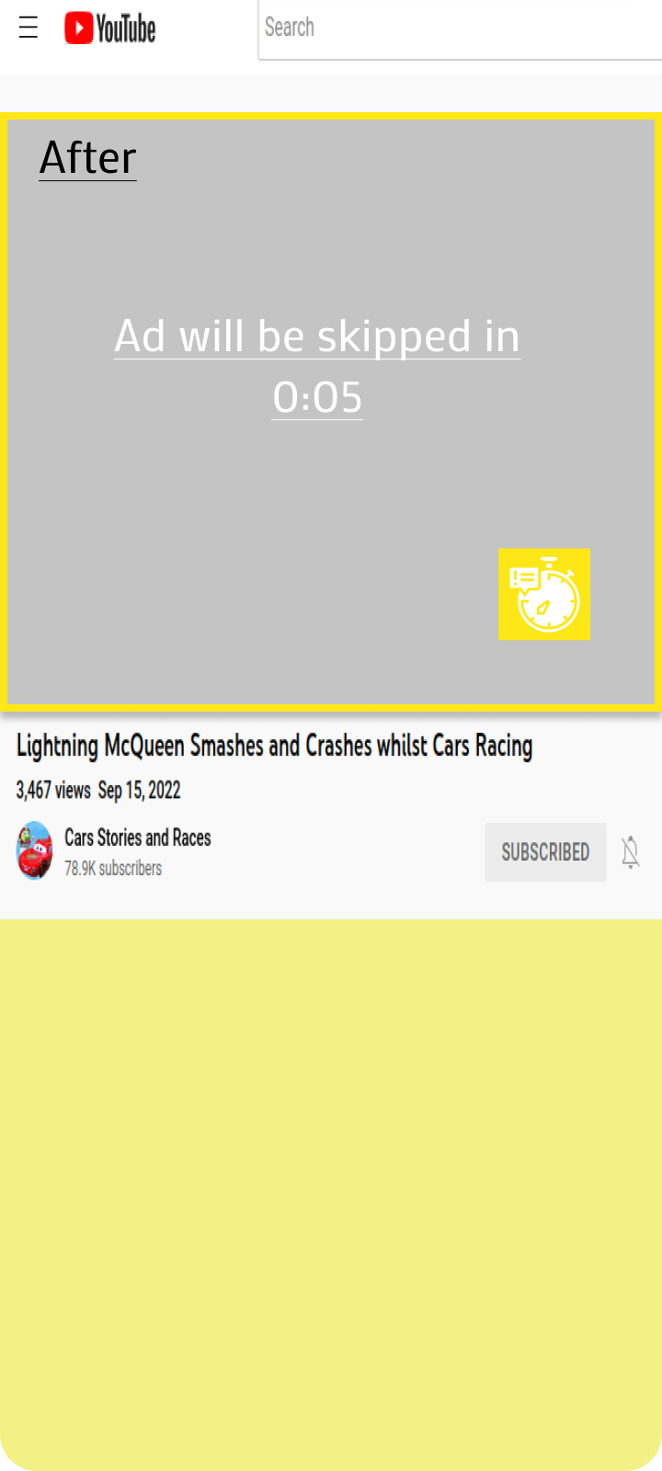
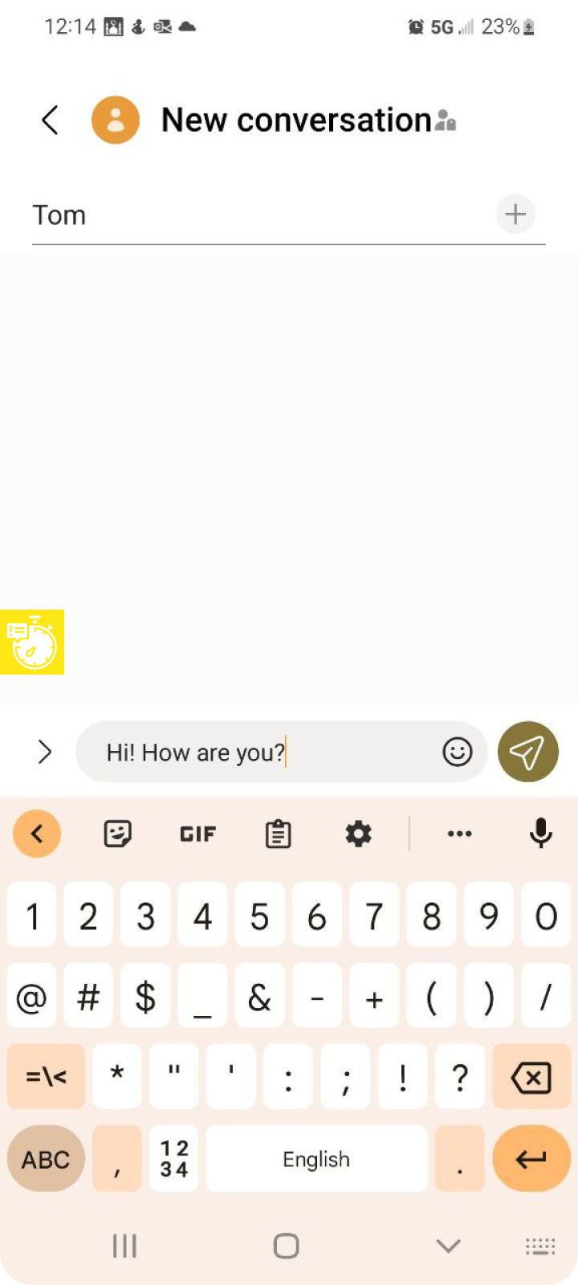
Blocks ads while viewing content online.
Notify the parent or guardian of the child if the child uses harmful or violent words while typing on the keyboard.

Slide 22
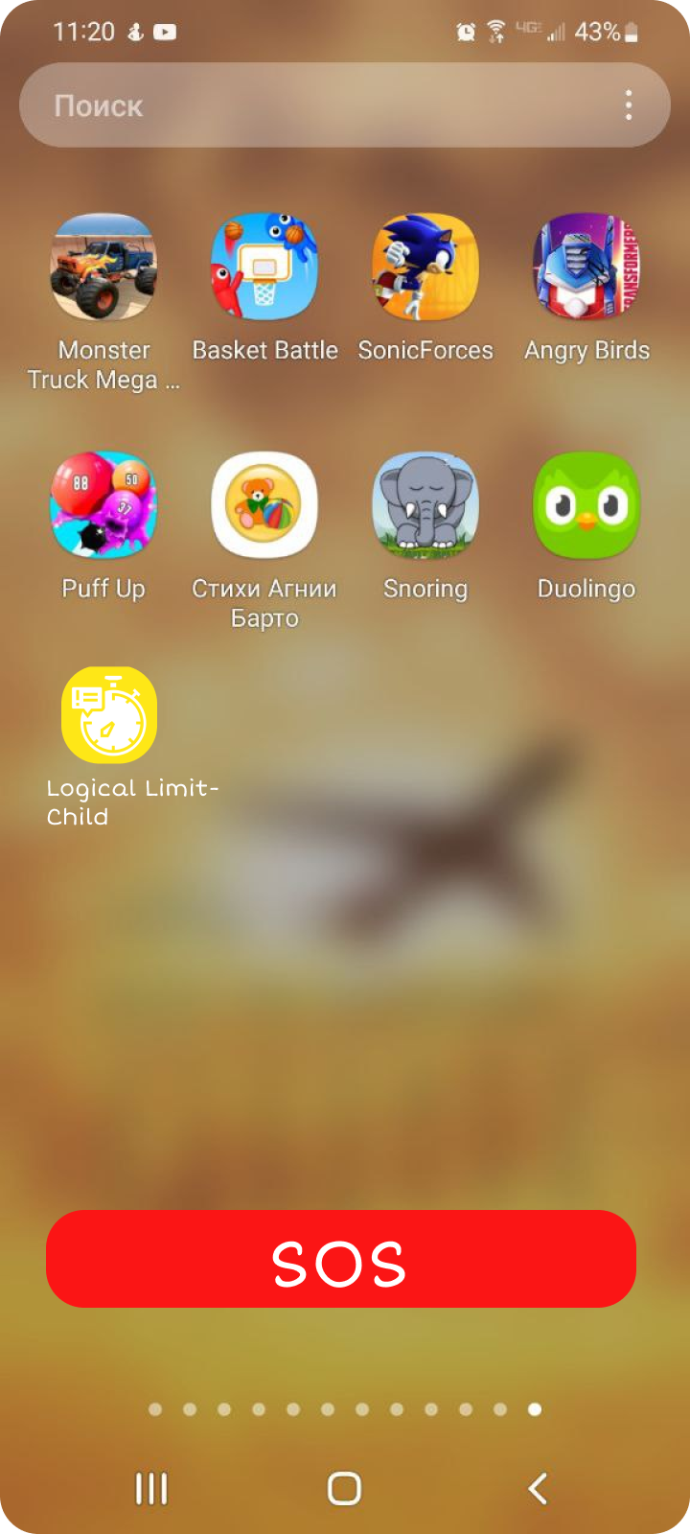
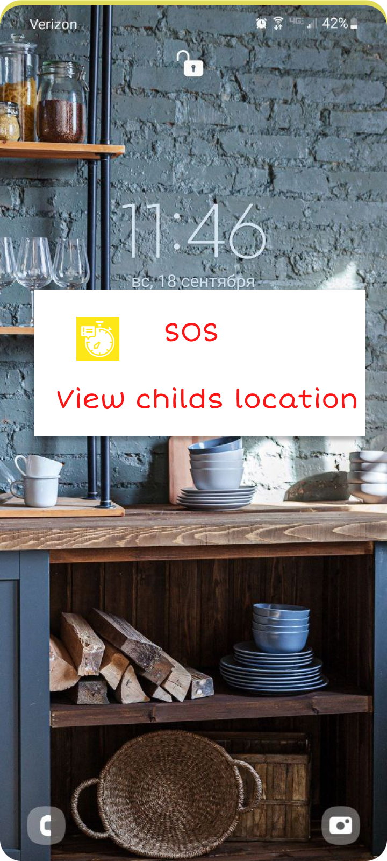
SOS button always displayed in child's device.
It will send the location of a child to parent's device with loud notification

